Slide 1
Advancing Equity in PA through Continuous Improvement

Slide 2
Discussion topics
Designing a system fit for PA’s context
Establishing a common vision
Building capacity at every level

Slide 3
Designing a system fit for PA’s context

Slide 4
Pennsylvania’s K-12 education landscape
K-12 education system serves more than 1.7 million students
  500 school districts, ranging in size from 200 to more than 140,000 students
  160 brick-and-mortar charter schools and 14 cyber charter schools, responsible for educating 135,000 students

Slide 5
Pennsylvania’s K-12 education landscape
60 percent of districts serve fewer than 2500 students

Slide 6
Pennsylvania’s K-12 education landscape
328 districts (66 percent) report a lean administrative structure (i.e., the Superintendent serves as the direct supervisor of school leaders)

Slide 7
Pennsylvania’s migrant population
Approximately 5,363 (birth through out-of-school) were served in SY 2017-18
  78% school-age; enrolled in 157 different school districts across the state (ranging from 1 to 1,331 per district)
  80.2% Temporary; 20.1% Seasonal
  61 birth countries
  85% non-fluent in English

Slide 8
Establishing a common vision for continuous improvement in PA
Notes:
The mission of the PA Department of Education is to ensure that every learner has access to a world-class education system that academically prepares children and adults to succeed as productive citizens. Further, the Department seeks to establish a culture that is committed to improving opportunities throughout the commonwealth by ensuring that technical support, resources, and optimal learning environments are available for all students, whether children or adults.
Vision: Pennsylvania learners will be prepared for meaningful engagement in postsecondary education; in workforce training; in career pathways; and to be responsible, involved citizens.

Slide 9
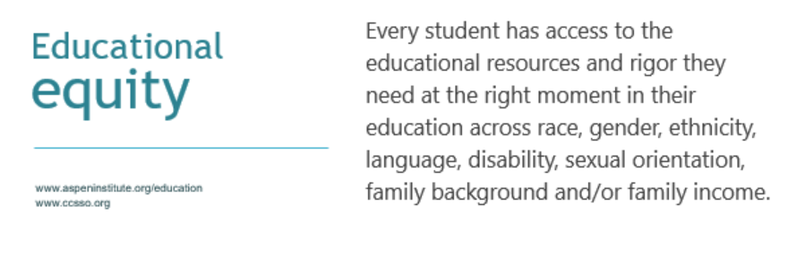
Establishing a common purpose

Slide 10

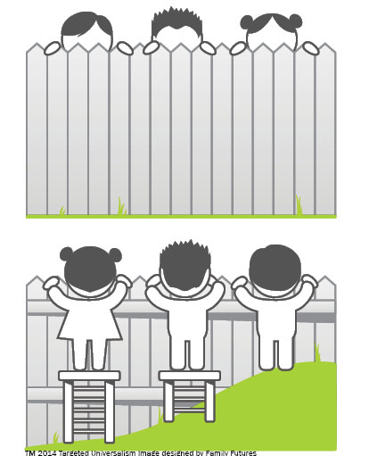
Improvement through an equity lens
Notes:
Examining data through an equity lens helps identify and investigate achievement or opportunity gaps.
Our latest MEP CNA found gaps in achievement between migrant children and youth and their peers in the areas of reading, math, and graduation.
Comparing data through an equity lens creates an environment in which trained educators will utilize analysis techniques that include consideration of factors such as: multiple types of data, multiple sources, comparisons across groups, benchmarking, and longitudinal data.

Slide 11

Conditions impact needs and opportunities
Image source: familyfutures.net
Notes:
You can not decouple the needs of students and communities from the success of schools.

Slide 12
Building capacity across the system

Slide 13
Agreeing on the key levers
Comprehensive Review
Literature review
Consultation
Gaps in PA’s Prior School Improvement Initiatives
Superficial consideration of root causes
Key Levers for Improvement in PA
Focus on Essential Practices
Limited collaboration between the SEA and LEAs
Local reflection
Lacked focus on human capital
Differentiate supports
Engage stakeholders
Prioritize human capital systems
Establish coherence and collaboration – horizontally and vertically
Notes:
What will it take to influence real change on behalf of the children and families we serve?
Acknowledgement that change is necessary
Will to change
Voice in change strategy
Environment that supports intellectual risk-taking

Slide 14
Fostering shared responsibility at every level

Slide 15
Defining meaningful stakeholder engagement
Stakeholders: community members who are involved and invested in LEAs, schools, programs, and outcomes for students
Engagement: process of communicating to, learning from, and partnering with stakeholders
Meaningful: inclusive, clear, effective and ongoing in order to best support educational equity and excellence
CCSSO & Partners for Each and Every Child. (2017). Meaningful local engagement under ESSA: A handbook for LEA and school leaders
Notes:
Schools can’t do it alone. Growing demands on teachers, principals, and district officials to be accountable for the success of all children are critical factors driving this change. To help all students succeed, these principals are convinced that schools and communities must pay attention to the multiple dimensions of young people’s lives. They pay attention to academics, but they also direct attention to other factors that influence the development of young people—including physical, social, and emotional health; a motivating, engaging, and safe environment; and family and community support.
ESSA provides LEAs with a unique opportunity to redefine the way they engage with their stakeholders. Engagement practices in the past have varied widely across LEAs, with some more intentional than others, leaving many groups feeling disconnected and unheard. ESSA’s focus on engaging all stakeholders provides LEAs with a chance to change their cultures and practices of engagement of all stakeholders – with particular attention to those who have been historically less connected to their work.

Slide 16
Power of meaningful stakeholder engagement
Engaging stakeholders is not only required under the law but is a strong best practice to effectively improve schools.
  Making decisions on education policy in an inclusive and transparent way leads to better decisions and encourages stakeholders to contribute and become partners in achieving the goals in the state and local community.
  Communities will support improvement strategies that they help to develop.
  Partnerships with a diversity of stakeholders, including parents, philanthropy, community-based organizations, and others will build local capacity to implement innovative and ambitious strategies for meeting the needs of all students.
Meaningful local engagement under ESSA: A handbook for LEA and school leaders

Slide 17
Stakeholder groups to engage
Think about the student group(s) of focus. Who would you engage?
  Students (current and alumni)
  Parents/guardians, families, and communities
  District-level educators
  School-level educators (including support staff)
  Early learning leaders
  Libraries
  Elected officials
  Agencies and governmental bodies
  Advocacy organizations
  Civil/human rights organizations
  Faith-based organizations
  Community food banks
  Local employers
  Refugee resettlement agencies
Meaningful local engagement under ESSA: A handbook for LEA and school leaders
Notes:
Rosemary
See “Stakeholders to Engage” in Part 4: Reference for helpful details
It is important to make extra efforts to engage with underrepresented and historically marginalized stakeholders. It is important to include voices representing students whose needs are not currently being met.

Slide 18
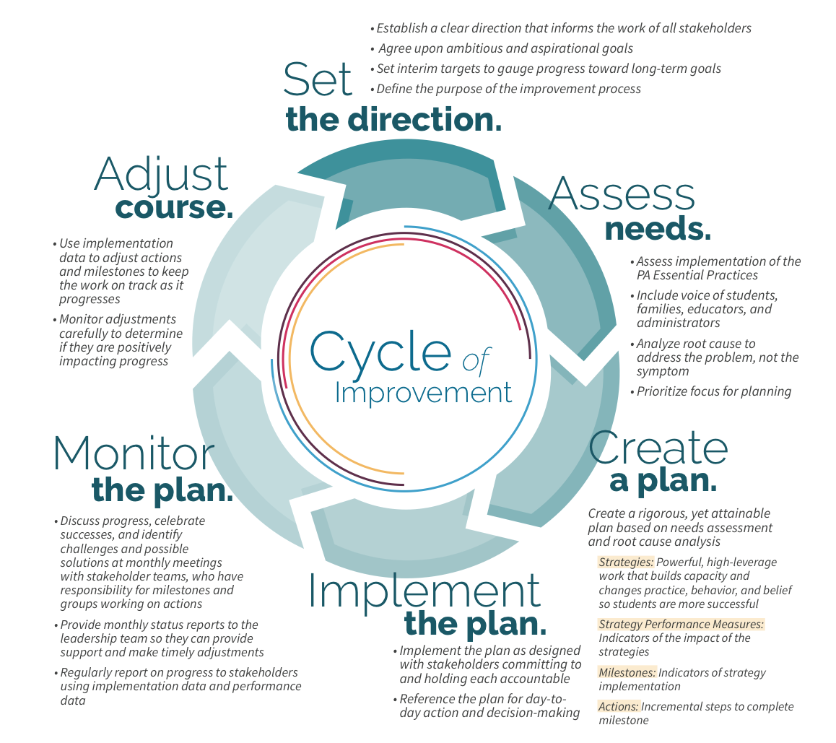
Shifting from compliance to effective process
DOCUMENT
Layland, A. & Corbett, J. (2017). Utilizing Integrated Resources to Implement the School and District Improvement Cycle and Supports.

Slide 19
Focusing on ‘quality improvement’

Slide 20
Building SEA Capacity
Develop an Implementation Plan with Clear Targets and Strategies
Develop the Vision for Continuous Improvement
Cultivate Relationships With Key Stakeholders to Build and Sustain Momentum
Build Capacity to Advance the Vision for Continuous Improvement
Establish Systems to Effectively Implement and Monitor Progress
Notes:
ESSA asks states to do new and different work in the school improvement arena - to set conditions that drive change, not just implement a specific set of federally-defined strategies.
State actions that foster improvement:
Develop the vision for continuous improvement:
Establish an agency culture that creates conditions and supports continuous improvement
Adopt a clear and transparent vision for school improvement
Prioritize support and coherence over transactional oversight
Invest in meaningful and cohesive district, school leadership and teacher development
Invest in collection and data systems to identify effective and ineffective systems
Effectively engage the state-wide community, building a strong constituency for reform
Develop an implementation plan with clear targets and strategies:
Prioritize improvement and communicate urgency
Collectively set the strategic direction for improvement
Develop and monitor district comprehensive plans, focused on continuous improvement
Customize and target support for school districts
Build a strong statewide community, intensely focused on college, career and community readiness
Establish systems to effectively implement and monitor progress:
Regular meetings with (identified program facilitators)
Provide, coordinate, and monitor LEA support systems and services
Continuously engage LEAs to support learning
If we improve our capacity to diagnose and correct the systemic issues that undergird performance challenges in individual schools we will increase the efficiency and efficacy of school improvement efforts and sustain progress over time
Building capacity to advance the vision for continuous improvement:
Shifting focus from transactional to strategic
Streamlining processes (e.g., Comprehensive Planning)
Investing in partnerships (PATTANs, IUs, Mid-Atlantic Comprehensive Center, Regional Education Lab, higher education partners)
Cultivate relationships with key stakeholders to build and sustain momentum
Stakeholder engagement has been central to every aspect of our school improvement planning
Forming a School Improvement Advisory group to ensure regular opportunities for stakeholders to come together to react to our plans, inform our thinking, and ensure a statewide lens (urban, rural, suburban) for our work

Slide 21
Contact/Mission
For more information on continuous improvement initiatives in PA, please visit PDE’s website at www.education.pa.gov
The mission of the Department of Education is to ensure that every learner has access to a world-class education system that academically prepares children and adults to succeed as productive citizens. Further, the Department seeks to establish a culture that is committed to improving opportunities throughout the commonwealth by ensuring that technical support, resources, and optimal learning environments are available for all students, whether children or adults.

